Slide 1
Analyzing Median House Prices and School Ratings for Scarborough Canada for Immigrants

Slide 2
Project Description
Due to various reasons like Jobs, Business many people migrating to various states of Canada and it requires search of a good housing prices as well as good rating schools for their children.
This projects aim is to create an analysis of features for a neighbourhood as a comparative analysis between neighbourhoods. The features include median house price and school ratings, crime rates, weather conditions, recreational facilities. This would help people to get awareness of the places before moving to a new country, state, city or place for their work or to start a new life
Also this project helps people explore different possibilities and take a better decision on choosing the best neighbourhood out of many neighbourhoods in Scarborough city based on the distribution of various facilities in and around that neighbourhood

Slide 3
Data
Longitude and Latitude Data:
We will need geo-locational information about that specific borough and the Neighbourhoods in that borough. It is "Scarborough" in Toronto. This project will require knowledge of the different Neighbourhoods in Toronto, school ratings and median house prices. As such the Neighbourhood data required will be:
Neighbourhood location in terms of latitude and longitude
School Ratings
Median House Prices
Dataset comprising latitude and longitude, zip codes is already available through the previous notebook. The location of Scarborough would be filtered using the same:
https://github.com/manojarum/CapstoneProjectRepo/blob/master/Segmenting%20and%20Clustering%20Neigh%20in%20Toronto%20T2.ipynb

Slide 4
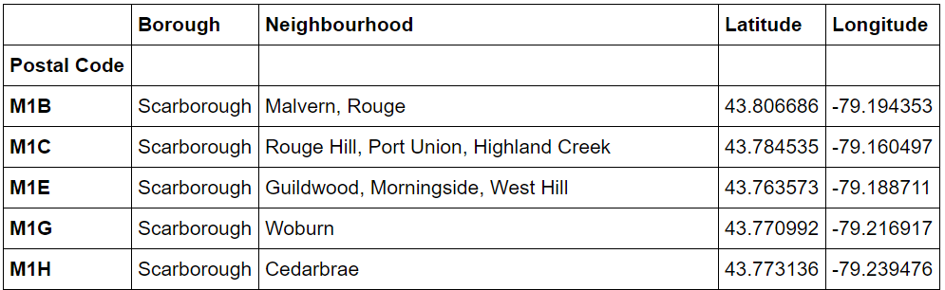

Slide 5
Foursquare API
We will need data about different venues in different Neighbourhoods of that specific borough. To gain that information, we will use "Foursquare" locational information. Foursquare is a location data provider with information about all manner of venues and events within an area of interest. Such information includes venue names, locations, menus and even photos. As such, the foursquare location platform will be used as the sole data source since all the stated required information can be obtained through the API. After finding the list of Neighbourhoods, we then connect to the Foursquare API to gather information about venues inside every Neighbourhood. For each Neighbourhood, we have chosen the radius to be 100 meters.

Slide 6
Data Preprocessing
Processing the Retrieved Data and Creating a DataFrome for All the Venues inside the Scarborough
Once data is obtained, we will perform processing on that raw data to find our desirable features for each venue.

Slide 7
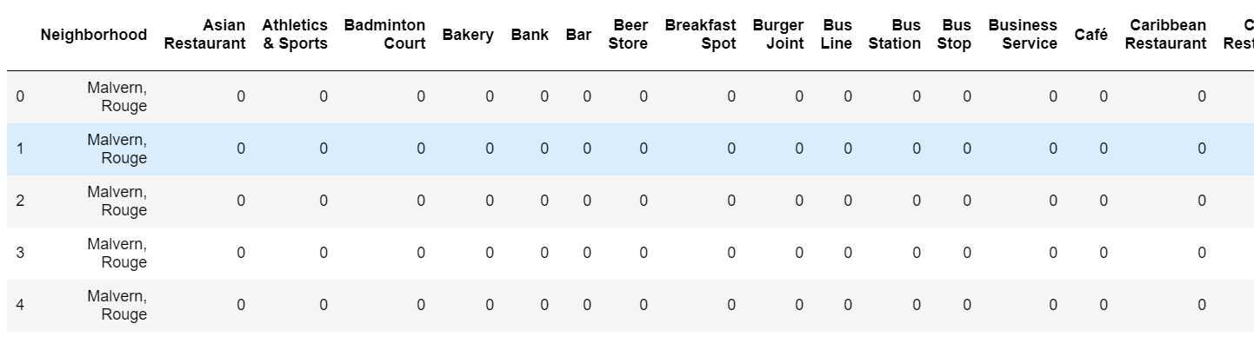
Creating a Data Frame
Processing the Retrieved Data and Creating a Data Frame for All the Venues inside the Scarborough

Slide 8
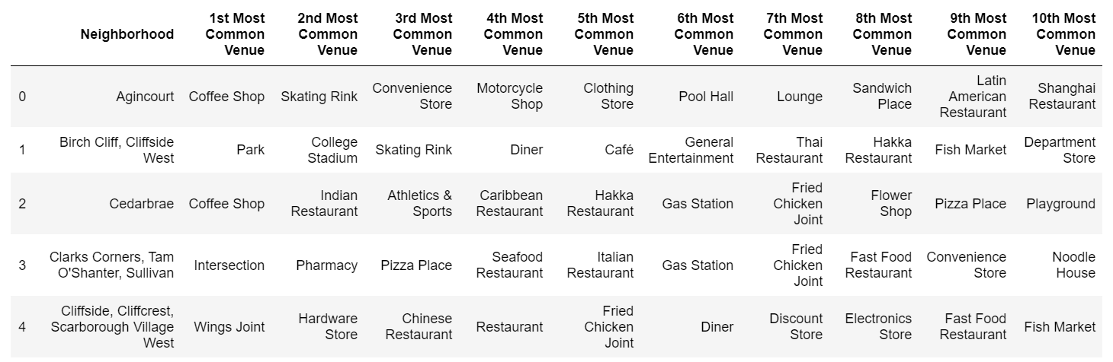
Most Common Venues

Slide 9
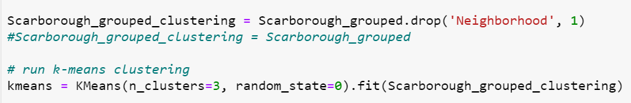
Clustering

Slide 10
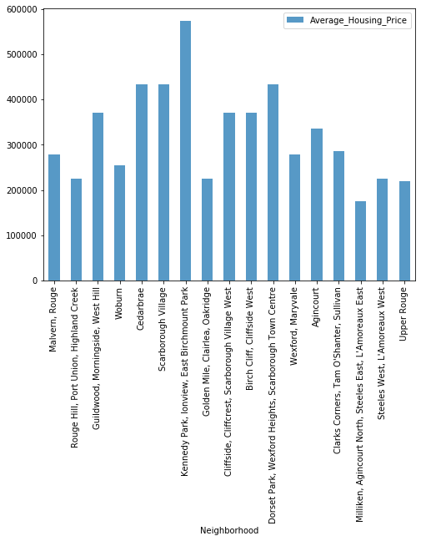
Neighborhood Median House Ratings

Slide 11
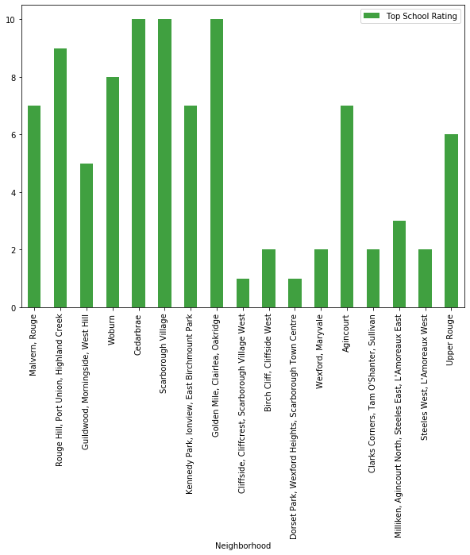
Neighborhood School Ratings

Slide 12
Conclusion:
In this project, through a k-means cluster algorithm we separate the neighborhood into 03 clusters, which have similar neighborhoods around them. Using the charts above decision leading to a particular neighborhood based on average house prices and school rating can be made

Slide 13
Thanks

